Slide 1

SOEN 6431 Software Maintenance and Program Comprehension
Dependency Management and Continuous Integration

Slide 2
Maven
What is Maven? A Java build tool based on ANT
Advantages of using Maven:
Facilitates build process
Provides a uniform build system
Simplifies dependency management
breaks down the build lifecycle into phases
plugins can be injected in any phase
provides guidelines for development best practices
Disadvantages of Maven:
Small learning curve

Slide 3

Introduction
Java projects originally managed with Ant
Manual build process
Ant scripts to compile, generate IDL, jar
Low-level scripting
No dependency management
No version management
Maven provides high-level features for build process
Notes:
3

Slide 4
Introduction
What is Maven?
“Maven is a software management and comprehension tool based on the concept of Project Object Model (POM) which can manage project build, reporting, and documentation from a central piece of information”
What is POM?
“As a fundamental unit of work in Maven, POM is an XML file that contains information about project and configuration details used by Maven to build the project”

Slide 5
Objectives and Characteristics of MAVEN
Maven is more than just Build Tool
Maven was built considering certain objectives
Maven Provides:
Easy Build Process
Uniform Build System
Quality Project Information
Guidelines for Best Practices Development
Achieved Characteristics:
Visibility
Reusability
Maintainability
Comprehensibility “Accumulator of Knowledge”

Slide 6

Provides a uniform build system
- Build process is external to IDEs
- Guarantees that everyone can build it
- What about IDE debug mode?
- IDE plugins exists for many platforms to allow this
- Build configuration is specified in pom.xml file
- version information
- classpath settings
- dependencies
- plugin data

Slide 7
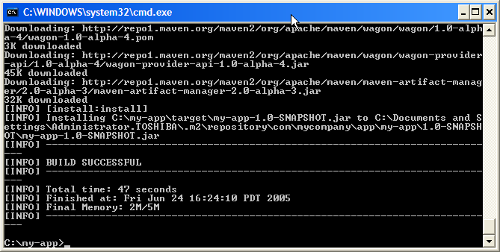
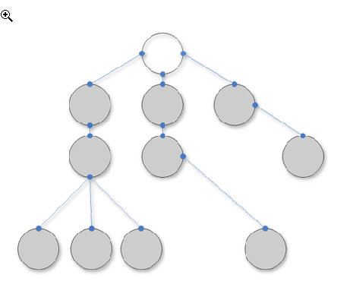
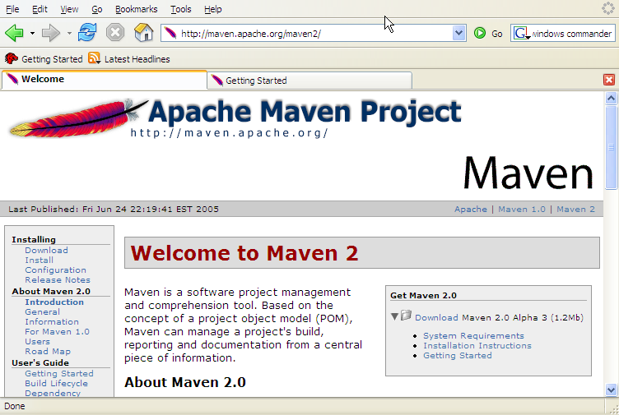
Main Features of MAVEN
Build-Tool
Dependency Management Tool
Documentation Tool

Slide 8
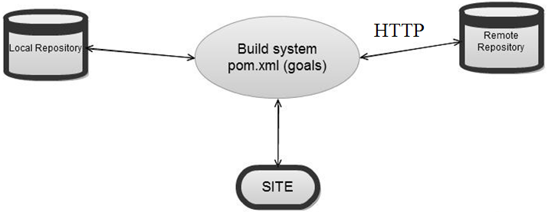
Overview of Simple Architecture
Notes:
A repository in Maven is used to hold build artifacts and dependencies of varying types
The local repository refers to a copy on your own installation that is a cache of the remote downloads, and also contains the temporary build artifacts that you have not yet released.
Remote repositories refer to any other type of repository, accessed by a variety of protocols such as file:// and http://. These repositories might be a truly remote repository set up by a third party to provide their artifacts for downloading

Slide 9
Build Lifecycles
Made up of Phases. Some of the common ones are:
validate - validate the project is correct and all necessary information is available
compile - compile the source code of the project
test - test the compiled source code using a suitable unit testing framework.
package - take the compiled code and package it in its distributable format, such as a JAR.
integration-test - process and deploy the package if necessary into an environment where integration tests can be run
verify - run any checks to verify the package is valid and meets quality criteria
install - install the package into the local repository, for use as a dependency in other projects locally
deploy - done in an integration or release environment, copies the final package to the remote repository for sharing with other developers and projects.
- There are ways to circumvent
mvn intall -DskipTests=true

Slide 10
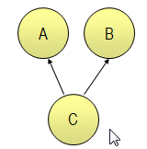
Dependency Management
« Any Version After 1.0 »
<dependencies> <dependency> <groupId>com.acme</groupId> <artifactId>B</artifactId> <version>[1.0,)</version> <scope>compile</scope> </dependency> </dependencies>
Artifact
Repository
(Local)
Artifact
Repositories
(Remote)
Build C
Look for A & B
Look for A & B

Slide 11

Simplifies dependency management
- All dependencies are specified in the pom
- Artifact repositories
- Local
- Remote
- No more JAR hunting on the web
- No more unknown versions of JARs in production releases
- Versions of common JARs can be specified in parent pom
<dependency>
<groupId>org.springframework</groupId>
<artifactId>spring</artifactId>
<version>2.5.5</version>
</dependency>

Slide 12
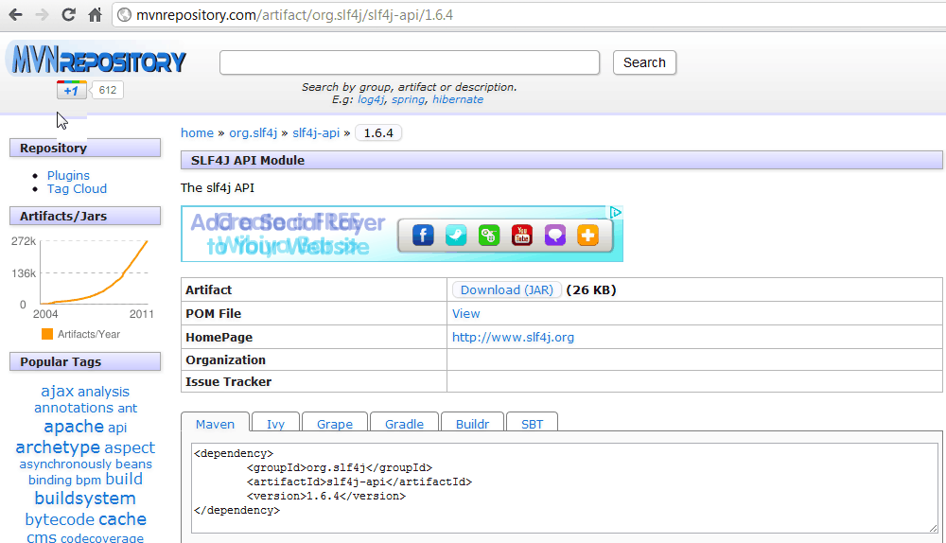
Dependency Management

Slide 13
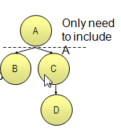
Transitive Dependencies
Allows automatically inclusion of libraries
Avoids the need to discover and specify the required libraries that your own

Slide 14
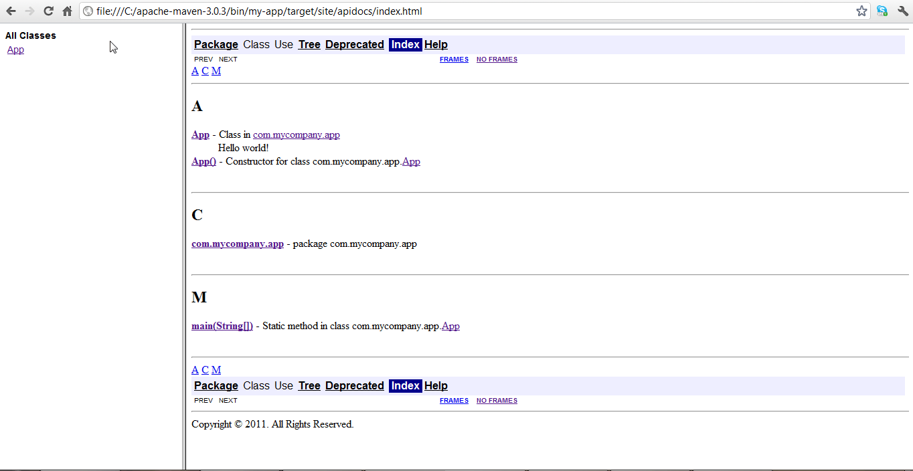
Report Generation

Slide 15
Continuous Integration (CI) What ?

Slide 16

What is Continuous Integration?
“ Continuous Integration is a software development practice where members of a team integrate their work frequently, usually each person integrates at least daily - leading to multiple integrations per day. Each integration is verified by an automated build (including test) to detect integration errors as quickly as possible.“
http://martinfowler.com/articles/continuousIntegration.html

Slide 17
What is Continuous Integration?
“The Daily Build on Steroids”
or…
“The practice of integrating source code continuously”

Slide 18
What is “integration” ?
at a minimum:
Gather latest source together
Compile
Execute tests
Verify success
But it can also include other tasks such as:
Rebuild the database
Build release distribution
Run code analysis and coverage tools
Generate documentation

Slide 19

How often is continuously?
As frequently as possible
More like once per hour than once per day
Before leaving at the end of the day

Slide 20

When to integrate?
Implement just enough, then integrate
If using Test Driven Development, it forms a natural break in the cycle
Taking small steps
Test
Integrate
Code
Refactor

Slide 21
Why?
Regular feedback
For the integrator : “Did that work?”
For the rest of the team : “Is the build OK?
Reduces Risk overall
Reduce integration pain
No more ‘merge hell’
XP Mantra: Do the ‘hard things’ often so they’re not hard any more
Enables concurrent development
“We can both work on this today”
Increased automation
Don’t repeat yourself - automate to increase speed and to make less mistakes

Slide 22
How?

Slide 23
Technical pre-requisites
Source Code checked into Source Control
Automated (fast) build
Compile
Test
command line without interaction
Dedicated (communal) Integration Machine

Slide 24
Social pre-requisites
Developer discipline
Continuous means continuous, not ‘once per week’
Shared ownership

Slide 25
Automated CI
Automated Continuous Integration Server
CruiseControl, CruiseControl.NET, TeamCity, Bamboo, etc.
Detects changes in source control
Launches integration build
Publishes results

Slide 26
How does Automated CI Work?

Slide 27
Why use Automated CI?
Makes integration easy
Guarantees integration happens
Better feedback options
Encourages test automation
Through metrics

Slide 28


Immediate Feedback is Key

Slide 29
Social Issues - CI Etiquette
Fixing a broken build is the highest priority
“You broke it, you organise fixing it”
Do not check in on a broken build
It makes fixing it harder
Don’t leave until the integration runs successfully
Keep the build quick

Slide 30
Where next?
http://martinfowler.com/articles/continuousIntegration.html
http://cruisecontrol.sourceforge.net/
http://ccnet.thoughtworks.com/
Etc…

